Slide 1
Course No : EEE 4154 Course Name : Power System II LAB
OPEN ENDED PROJECT
Project name: Cost Effective Variable Frequency Drive
Presented By:
190205183-Md. Ekramul Hasan Sharon
190205184-Hashin Israq
190205185-Anamika Rahman Prity
190205186-Abdullah-Al- Noman
190205187-Abu Intisher Md. Niaz

Slide 2
OBJECTIVE
01
02
03
Find a cost effective way to develop VFD
Will vary the frequency between 17 to 250Hz
Must observe
the output
at load (bulb)

Slide 3
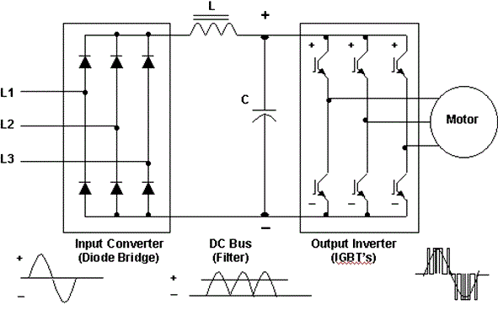
WHAT IS VFD(VARIABLE FREQUENCY DRIVE)
A power electronics based device
Converts a basic fixed frequency, fixed voltage sine wave power (line power) to a variable frequency, variable output voltage
Used to control speed of Induction Motor
Consist of Input Inverter, DC Bus filter and A output inverter

Slide 4
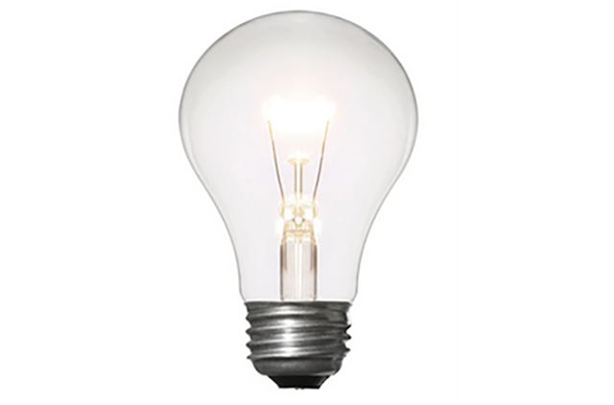
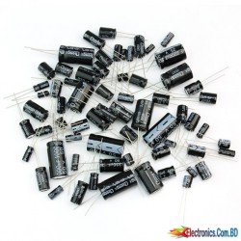
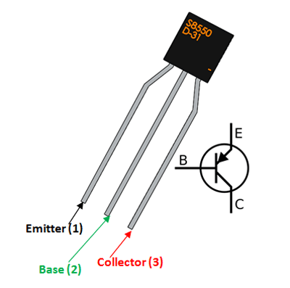
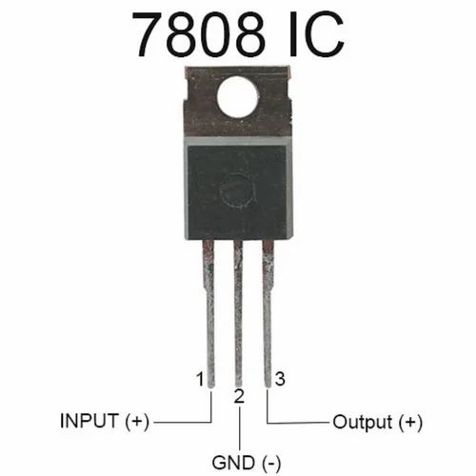
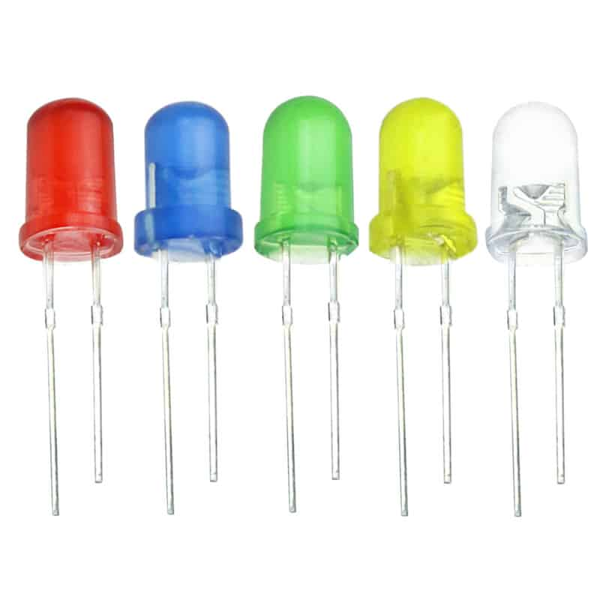
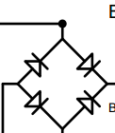
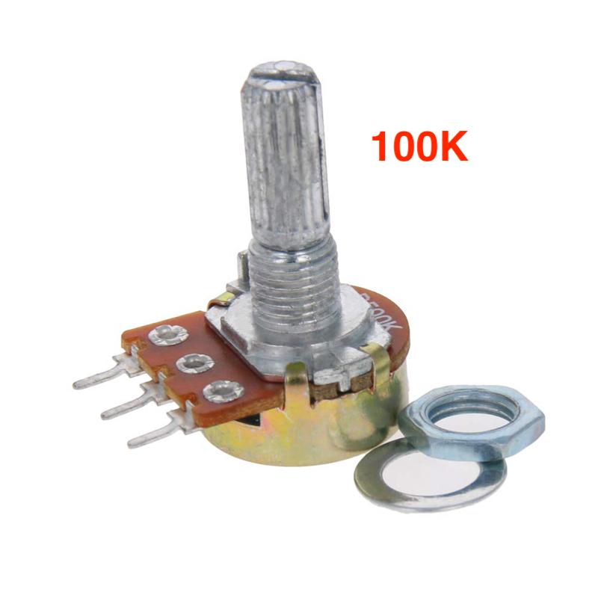
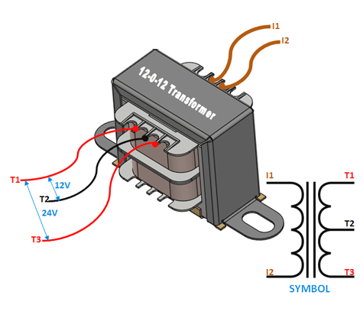
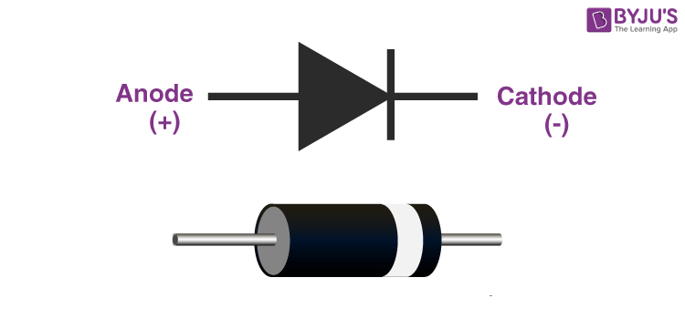
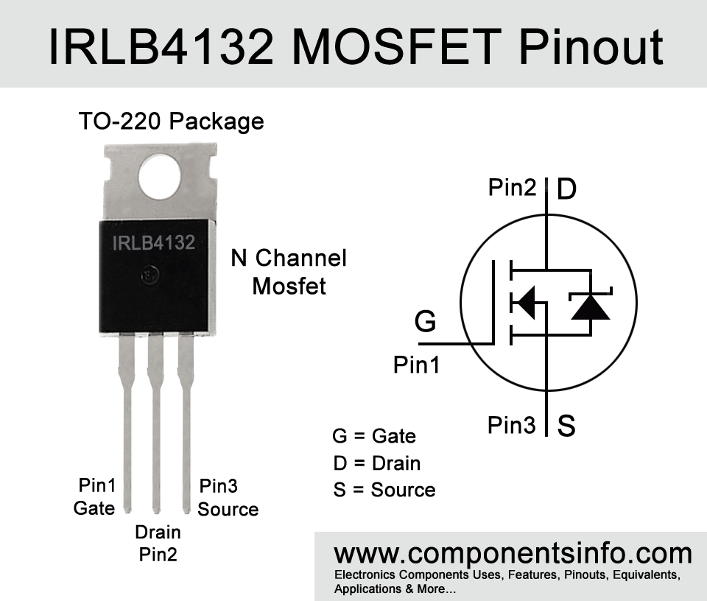
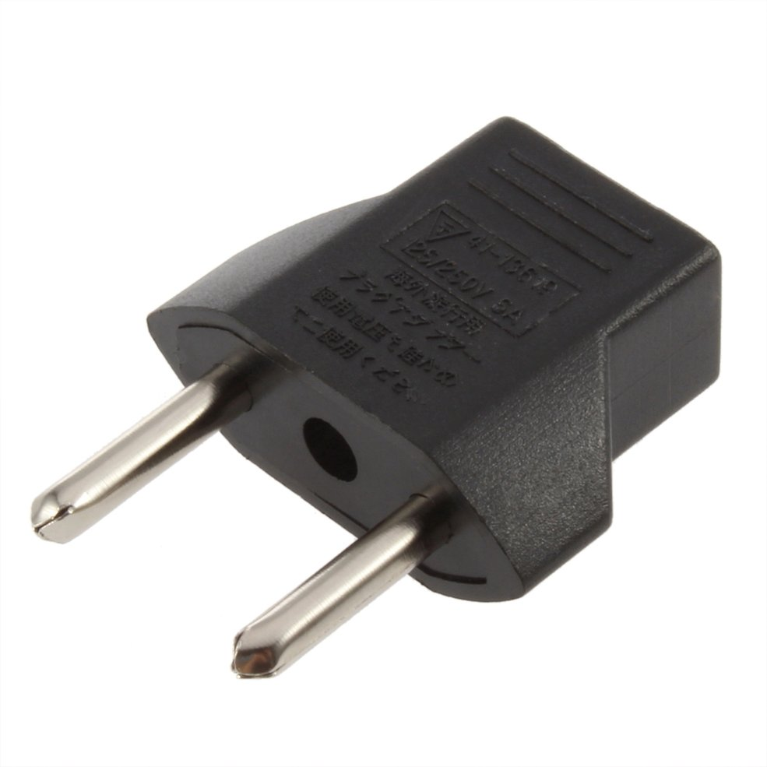
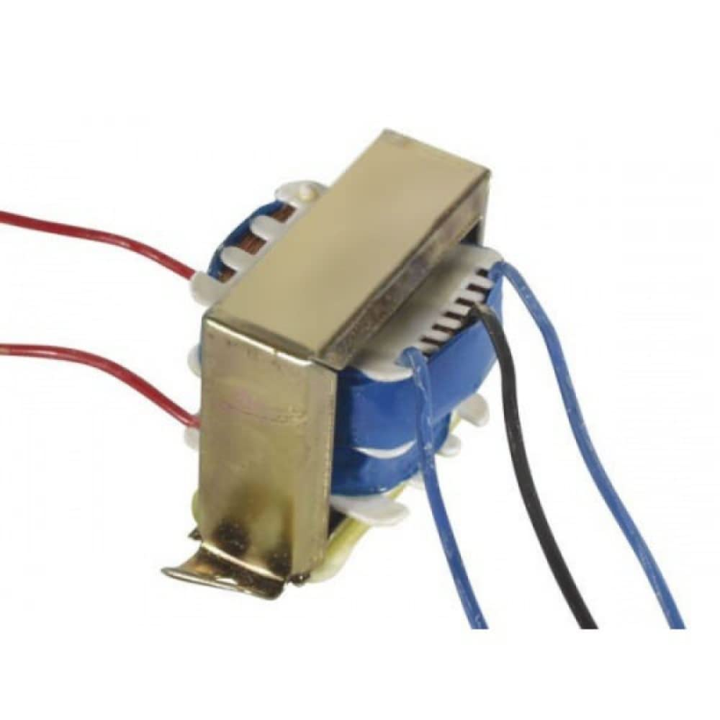
EQUIPMENTS
2-Pin plug
Center-tapped (220V-12V) step-down transformer
Resistance and 100K Potentiometer
Bridge Rectifier(4 diode)
Capacitor(2200uF, 10uF)
IC 7808 Voltage regulator
IRLB4132 MOSFET
Diode
ST8550D p-np BJT
LED
Center-tapped(9V-220V) step-up transformer
Load(Bulb)

Slide 5
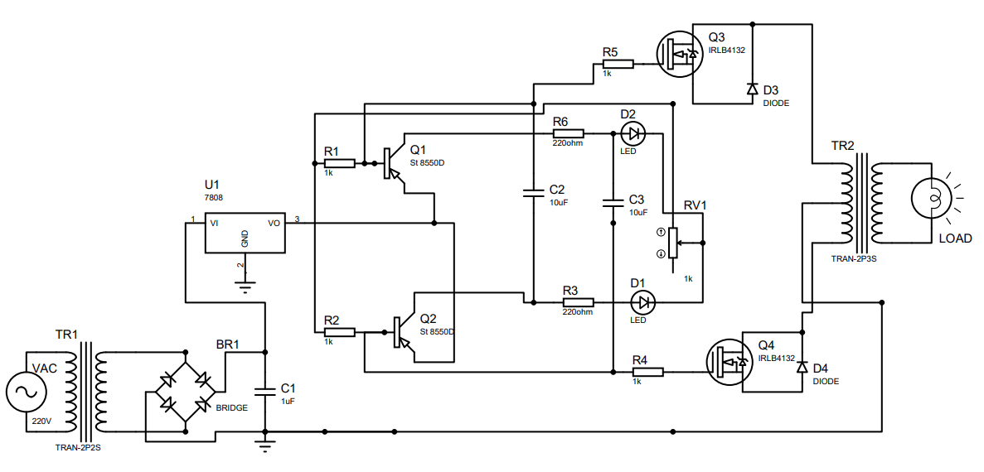
CIRCUIT OVERVIEW

Slide 6
WORKING PRINCIPLE
Using 100k rated potentiometer to vary the frequency
Variations of frequency could be seen at oscilloscope after set-up transformer
Introducing the Output of Voltage regulator to Switching transistor made using p-n-p transistor to control the MOSFET
Output AC conversion can be shown at inverter output using step-up transformer and using a load

Slide 7
EXPERIMENTAL ANALYSIS
Variation of frequency (17-250Hz)
Frequency at 0Hz
Potentiometer control over 250Hz
Use of LEDs
Production of precise frequency
Reduction the uses of inverter circuit
Cost limit

Slide 8
Advantages
disadvantages
Energy Savings
Process Control
Reduced Wear and Tear
Improved Efficiency
Smooth start & stop
Harmonics
Electromagnetic Interference (EMI)
Maintenance
Overheating

Slide 9
APPLICATIONS
HVAC (Heating, Ventilation, and Air Conditioning)
Industrial Manufacturing
Water treatment plants
Agriculture
Renewable Energy
Automotive Manufacturing
Elevators and Escalators

Slide 10
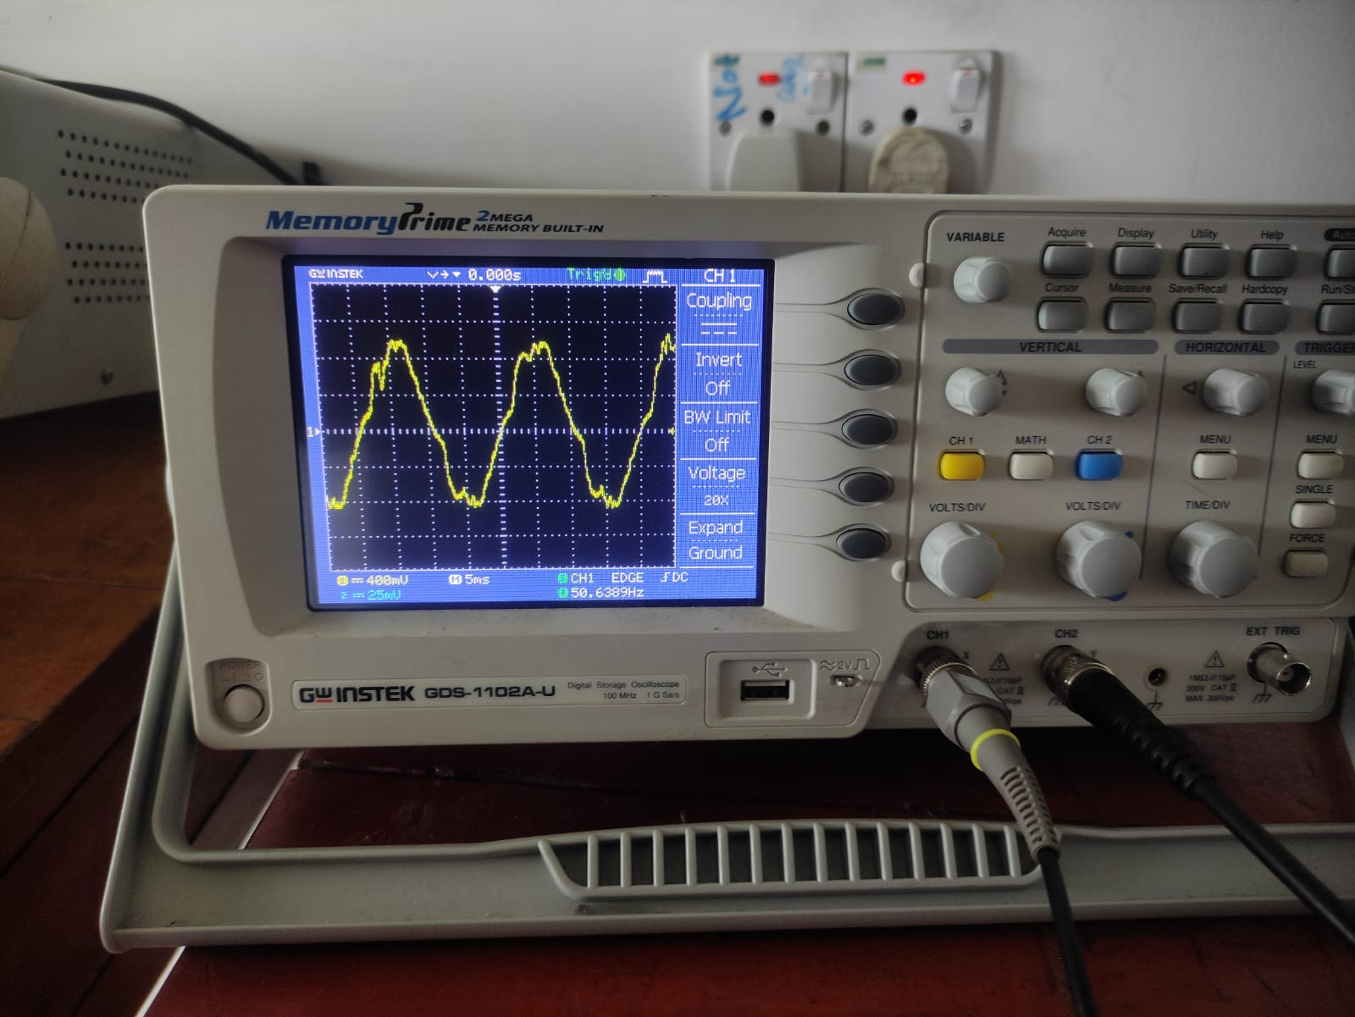
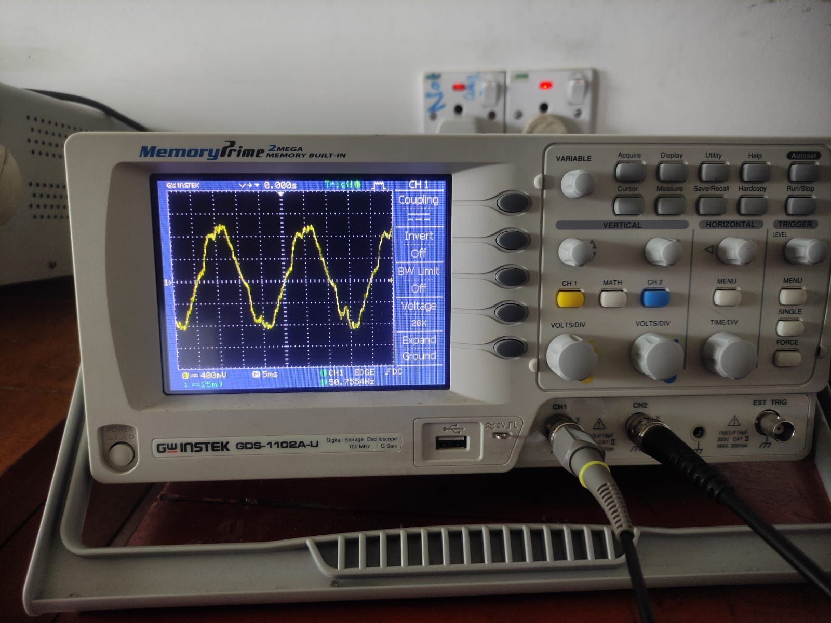
Final Output

Slide 11
Thank you

